Slide 1
Storytelling with Tableau
File created on: 07-03-2024 15:39:23

Slide 2
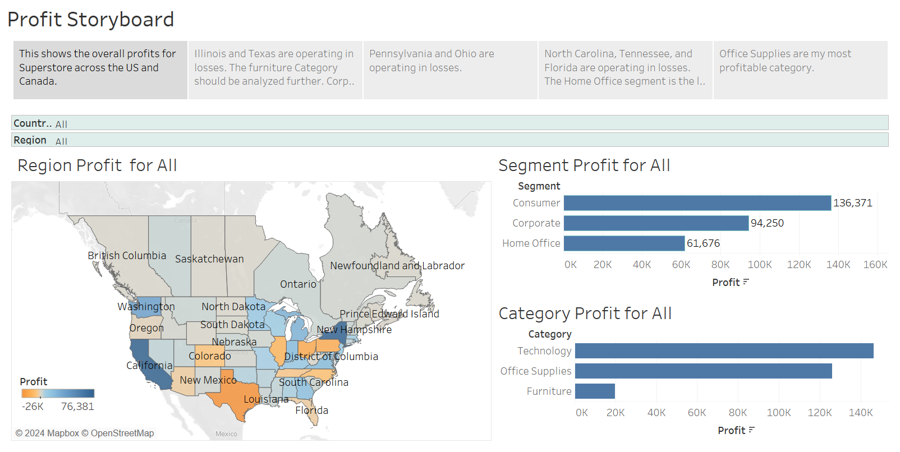

Slide 3
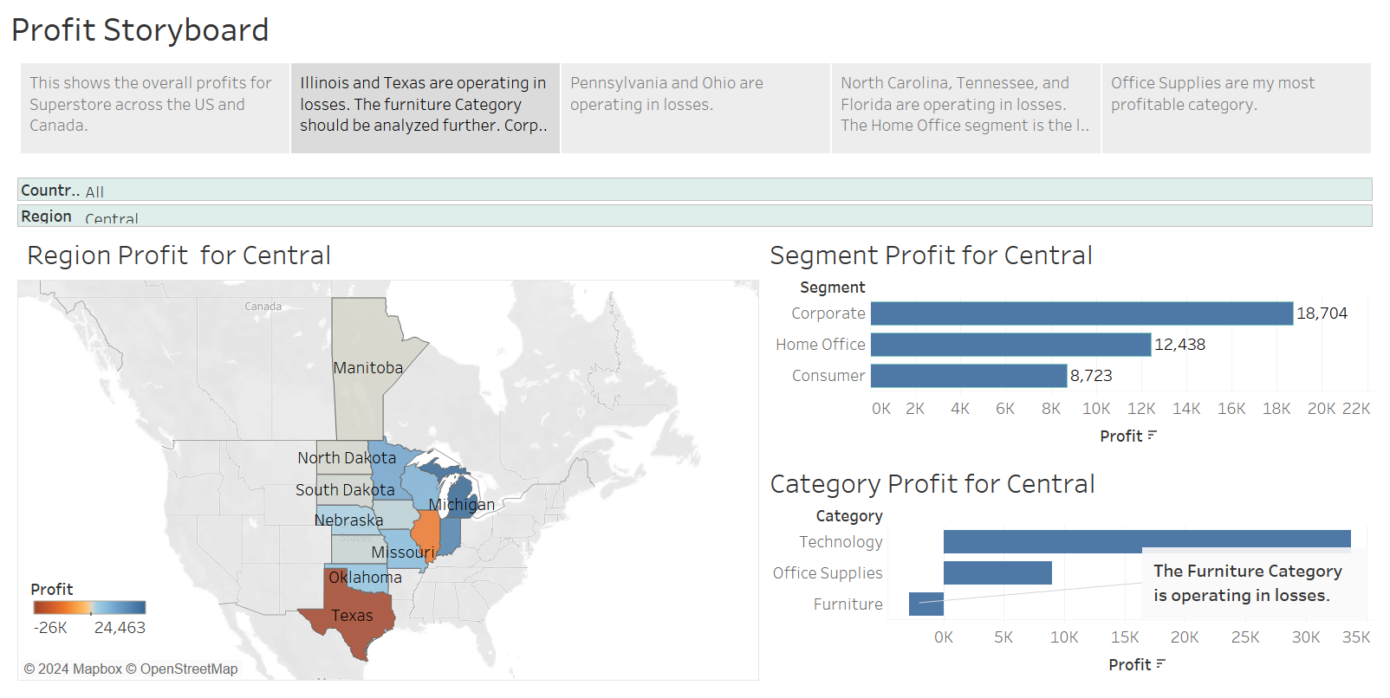

Slide 4
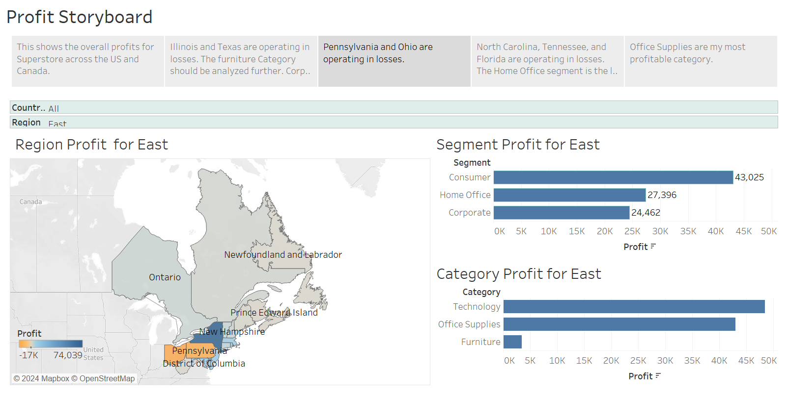

Slide 5
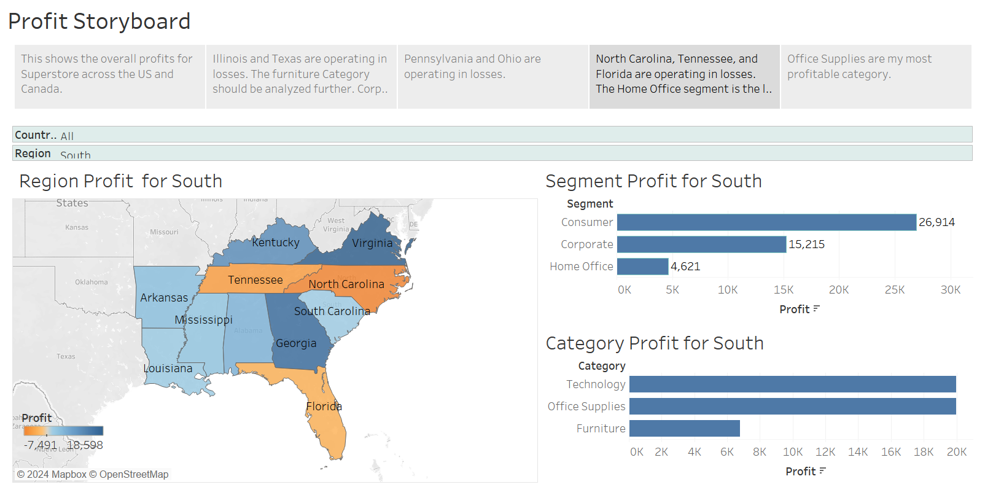

Slide 6
